Slide 1

Mini Project-I (K24MCA18P) Odd Semester Session 2024-25
REAL ESTATE MANAGEMENT
Prince Kumar(2426MCA692)
Samiksha Teotia(2426MCA838)
Neha Agnihotri(2426MCA684)
Project Supervisor:
MRS. Divya Singhal

Slide 2
Content
Introduction
Literature Review
Objective of the Project
Technology
Hardware Requirements
Software Requirements
Modules
Workflow
Reports
References
Notes:
Font Styles: Times New Roman + Font Size: 25

Slide 3
Introduction
Real estate management involves overseeing property transactions, rentals, maintenance, and tenant relationships. With the advent of technology, managing these tasks efficiently has become crucial. The MERN stack—comprising MongoDB, Express.js, React.js, and Node.js—offers a powerful framework for developing a robust real estate management application.
Components of the MERN Stack
MongoDB: A NoSQL database that stores data in JSON-like documents, making it flexible for handling diverse property information, tenant details, and transaction records.
Express.js: A web application framework for Node.js that simplifies routing and server-side logic, allowing for efficient API development to manage property listings, user accounts, and other backend services.
React.js: A front-end library for building user interfaces. It allows for the creation of dynamic and responsive components, enhancing user experience through real-time updates and seamless navigation.
Node.js: A runtime environment that enables JavaScript to be used on the server side, allowing developers to build scalable network applications. It can handle multiple requests simultaneously, which is essential for real-time property management.
Notes:
Font Styles: Times New Roman + Font Size: 25

Slide 4
Literature Review
1. User Interface and Experience Design
Best Practices: Summarize literature on UI/UX design principles specific to real estate applications, focusing on navigation, property listings, and search functionalities.
Responsive Design: Discuss the importance of mobile-friendly designs in the context of real estate platforms.
2.Security and Data Privacy
Regulatory Compliance: Review studies on data protection laws (like GDPR) and their implications for real estate applications.
Security Measures: Summarize best practices for securing web applications, particularly those handling sensitive user data.
3. Future Trends and Innovations
Emerging Technologies: Explore the potential integration of technologies like AI, machine learning, and blockchain in real estate applications.
User-Centric Innovations: Discuss how feedback loops and user testing can lead to improved features and functionalities in real estate platforms.
Notes:
Font Styles: Times New Roman + Font Size: 25

Slide 5
Objective of the Project
Enhance User Experience:
Develop a user-friendly interface that allows seamless navigation for buyers, sellers, and agents. This includes intuitive search filters, property comparison tools, and easy access to information.
Streamline Property Transactions:
Implement features that facilitate the entire transaction process, from listing a property to finalizing sales, including online booking for viewings and secure payment options.
Centralize Data Management:
Utilize MongoDB to create a centralized database that efficiently stores and manages property listings, user accounts, and transaction history, ensuring data integrity and easy retrieval.
Improve Communication:
Incorporate real-time messaging and notification systems to enhance communication between buyers, sellers, and agents, enabling quicker responses and better service.
Implement Secure Authentication:
Ensure robust security measures, including secure user authentication and authorization protocols, to protect user data and build trust in the platform.
Facilitate Market Analysis:
Provide analytical tools and dashboards that offer insights into market trends, property values, and user behavior, aiding users in making informed decisions.
Promote Property Listings:
Create features for sellers and agents to promote their listings effectively, including SEO optimization and social media sharing options.
Mobile Responsiveness:
Ensure the application is fully responsive and accessible on various devices, enhancing usability for all users, regardless of their preferred platform.
Support Future Scalability:
Design the application architecture to be scalable, allowing for easy integration of new features and support for increased user traffic as the platform grows.
Notes:
Font Styles: Times New Roman + Font Size: 25

Slide 6
Technology (Hardware Requirements)
Development Environment
Local Development Machines:
CPU: At least a dual-core processor (Intel i5 or AMD Ryzen 5) for smooth development.
RAM: Minimum of 8 GB (16 GB preferred) to run multiple applications, browsers, and IDEs efficiently.
Storage: SSD for faster read/write speeds, with at least 256 GB capacity to store project files and dependencies.
2. Testing and Staging Servers
Virtual or Physical Servers:
CPU: Quad-core processor for better multitasking and performance.
RAM: 16 GB or more to handle multiple instances and load testing.
Storage: SSD or high-speed HDD with a capacity of 512 GB or more, depending on the amount of data to be stored.
Network: Stable and high-speed internet connection for testing, especially if utilizing cloud services.
Notes:
Font Styles: Times New Roman + Font Size: 25

Slide 7
Technology (Software Requirements)
Frontend (React)
React: For building the user interface, utilizing components for a responsive design.
React Router: For client-side routing to manage different views (listings, property details, user profile, etc.).
State Management: Use tools like Redux or Context API for managing application state.
Form Libraries: Formik or React Hook Form for handling forms (e.g., property listings, user registration).
2. Backend (Node.js and Express.js)
Node.js: For building the server-side application.
Express.js: For routing and handling API requests.
Database Integration: Use Mongoose to interact with MongoDB for data modelling.
3. Database (MongoDB)
MongoDB: For storing property listings, user data, and inquiries.
Data Modeling: Define schemas for properties, users, and transactions.
Indexing: Optimize queries with proper indexing for performance.
Notes:
Font Styles: Times New Roman + Font Size: 25

Slide 8
Modules
The real estate website can be structured into several key modules, each focusing on different aspects of the functionality and user experience. Below are the primary modules to consider for the project:
1. User Authentication Module
2. Property Listing Module
3. Search and Filter Module
4. User Profile Module
5. Property Management Module (for landlords/agents)
6. Tenant Management Module
7. Payment Module
8. Analytics and Reporting Module
9. Content Management Module
10.Support and Feedback Module
Notes:
Font Styles: Times New Roman + Font Size: 25

Slide 9
Workflow/Gantt Chart
1. Project Planning
2. Requirements Gathering
3. System Design
4. Development Setup
5. Frontend Development (React)
6. Backend Development (Node.js and Express.js)
7. Testing
8. Deployment
9. User Acceptance Testing (UAT)
10. Launch
11. Post-Launch Maintenance
12. Future Enhancements
Notes:
Font Styles: Times New Roman + Font Size: 25

Slide 10
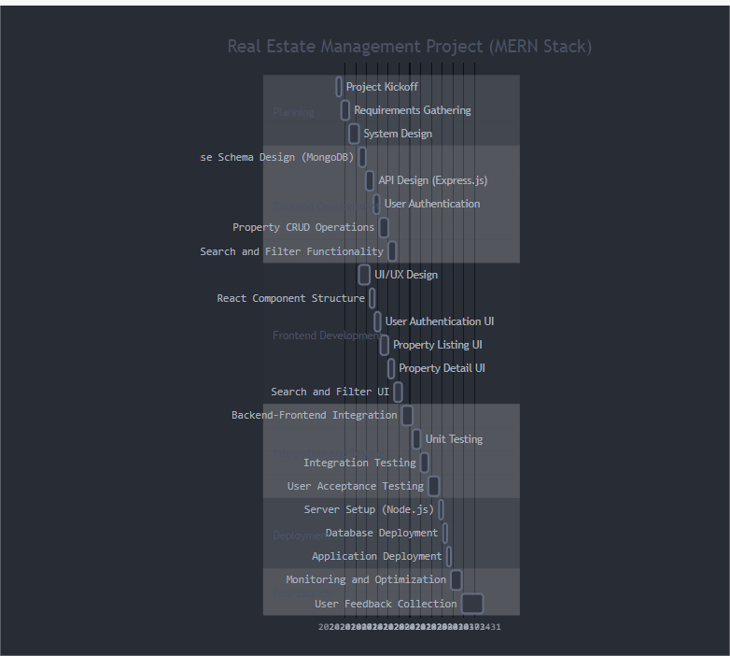

Slide 11
Reports
1.Project Proposal
Overview: Define the project’s goals, target audience, and key features.
Technology Stack: Justify the choice of the MERN stack for your project.
Timeline: Outline project phases, milestones, and deadlines.
2. Technical Specifications Document
Architecture: Describe the system architecture (frontend, backend, database).
API Documentation: Detail the RESTful API endpoints, including methods, parameters, and responses.
Data Models: Include MongoDB schemas for properties, users, and transactions.
3. User Stories and Use Cases
User Stories: Define user personas and their needs (e.g., buyers, sellers, agents).
Use Cases: Illustrate specific scenarios (e.g., searching for properties, submitting inquiries).
4. Market Research Report
Industry Analysis: Provide insights into the real estate market, trends, and competition.
Target Market: Identify demographics and preferences of potential users.
5. Development Report
Progress Updates: Summarize development milestones and challenges faced.
Code Review: Document any code quality checks or improvements made.
Notes:
Font Styles: Times New Roman + Font Size: 25

Slide 12
References
MERN Stack Official Documentation:
MongoDB
Express.js
React
Node.js
Comprehensive MERN Stack Tutorial:
FreeCodeCamp MERN Stack Course
YouTube Tutorials:
Traversy Media - MERN Stack Front To Back
Academind - MERN Stack Tutorial
Sample Projects and Repositories
GitHub Repositories:
MERN Real Estate App (Example project with full codebase)
MERN Boilerplate (Starter template for MERN apps)
Medium Articles:
Building a Real Estate App with MERN
MERN Stack Tutorial: Create a Full Stack App
Notes:
Font Styles: Times New Roman + Font Size: 25

